Slide 1
CSI3344 Distributed Systems
Lecture 7
CONSISTENCY
Contents
7.1 Data Replication: purpose and problem
7.2 Data-centric Consistency Models
(7.3 Client-centric Consistency Models
  -- as advanced reading)
CSI3344

Slide 2
CSI3344 Distributed Systems
Objectives
Outline purposes of data replication;
Be aware of the origin of data inconsistency;
Describe the principles of different consistency models.
CSI3344

Slide 3
Introduction
Data replication aims at improving the scalability and reliability / performance of a distributed system.
Replication introduces a problem – data inconsistency on replicated data in distributed systems.
To keep replicas consistent, we need consistency models to control temporary inconsistencies in replicated data.
CSI3344
Notes:
Use a message to Daniel
Message is written (start data communication)
Choose mail or fax (processes)
Fax to company
Daniel (not only one) Sumich (D S, not Peter S)
Department/company
Fax number
Mail to
Daniel (not only one) Sumich (D S, not Peter S)
Department/company
Address

Slide 4
7.1 Data Replication: Purpose and Problem (1)
Purposes
  Data are replicated to
  Increase the reliability / performance of a system;
  Scale the system in number of servers/users and geographical areas.
Problems
  Copies of replicated data may be inconsistent when one copy is modified.
    The modification has to be carried out on all copies to ensure consistency.
    When and how to carry out the modification determines the cost of replication.
CSI3344

Slide 5
7.1 Data Replication: Purpose and Problem (2)
Data store:
  A distributed collection of storage accessible by clients
  A broader term representing any one of the following traditional entities:
    shared data,
    shared memory, and
    shared database or file system.
  Data store may be distributed across multiple machines.
CSI3344

Slide 6
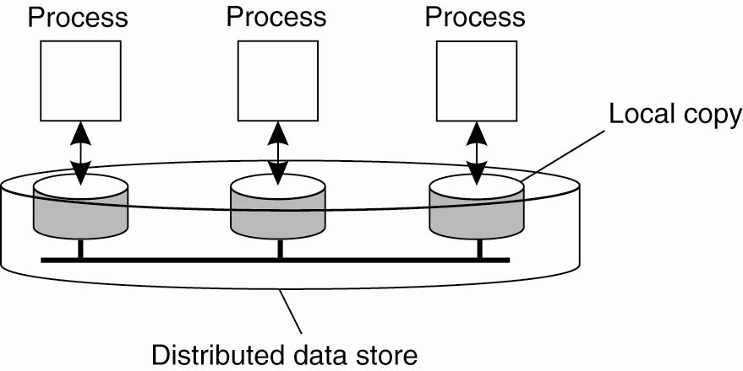
7.1 Data Replication: Purpose and Problem (3)
Data-centric Consistency Models
Figure 7-1. The general organization of a logical data store, physically distributed and replicated across multiple processes.
CSI3344

Slide 7
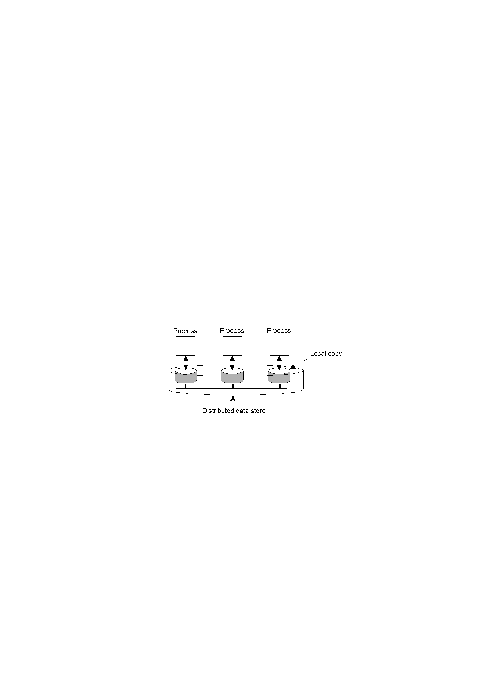
7.1 Data Replication: Purpose and Problem (4)
Process on data
  A process acts on data in data store by means of two operations: read and write.
  Assumption:
    Each process usually accesses a (local) copy of a data item in the nearest data store.
    A write operation on the local copy is then propagated from the local data store to the entire store.
CSI3344
Notes:
Read: corresponding to SELECT statement in SQL
Write: corresponding to INSERT/UPDATE/DELTE statements in SQL

Slide 8
7.1 Data Replication: Purpose and Problem (5)
Data operations
  Read – Returns a copy of data item/s, and keeps the data the same after the operation
    Theoretically, a process that performs a read operation on a data item expects the operation to return a value that indicates the information of the last write operation on that data item.
    e.g., after a SELECT statement was executed
  Write - changes the data after the operation
    Cannot guarantee without synchronization
  Notations
    R_{i}(x)v – a read operation by process p_{i} from data item x with a previous write operation result v.
    W_{i}(x)v – a write operation by process p_{i} to data item x with a (operation finishing) value (or indicator) v.
    (If no confusion occurs, use W(x)v for W_{i}(x)v)
CSI3344

Slide 9
7.2 Consistency Models (1)
Consistency model
  Essentially an agreement (or contract) between processes and the data store, which restricts processes to follow certain rules that make data store work correctly.
  Restrictions on returning a write operation value v to a read operation on a data item determine different consistency models.
  The models with minor restrictions are easy to use/implement, whereas those with major restrictions are sometimes difficult.
CSI3344

Slide 10
7.2 Consistency Models (2)
Classification of Data-centric consistency models
  Without synchronization operations (for individual operations)
    Strict consistency (absolute time ordering)
    Sequential consistency (not ordered in time)
    Causal consistency (in a causal order)
    FIFO consistency (first-in-first-out)
  With synchronization operations (grouping operations)
    Weak consistency (synchronization done first)
    Release consistency (lock-release a region)
    Entry consistency (entered into a region first)
CSI3344

Slide 11

7.2 Consistency Models (3)
Strict consistency (1)
  Necessary condition
    Any read on a data item x returns a value corresponding to the result of the most recent write on x.
      Rely on absolute global time
Strictly consistent store
CSI3344

Slide 12

7.2 Consistency Models (4)
Strict consistency (2)
  Necessary condition
    Any read on a data item x returns a value corresponding to the result of the most recent write on x.
      Practically Impossible!
Example: W1(x) and R2(x) from two machines 3 miles apart
Store that is not strictly consistent.
CSI3344

Slide 13
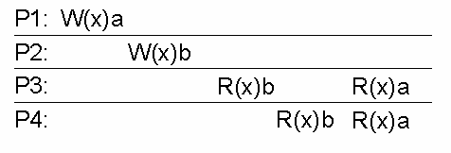
7.2 Consistency Models (5)
Sequential consistency (1)
  Necessary condition:
  The result of any execution is the same as if the R/W operations by all processes on that data store were executed in the same sequential order.
A data store consistent sequentially
CSI3344

Slide 14
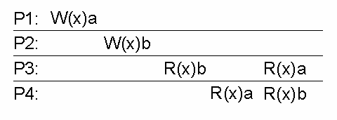
7.2 Consistency Models (6)
Sequential consistency (2)
  Necessary condition:
  The result of any execution is the same as if the R/W operations by all processes on that data store were executed in the same sequential order.
The two reads
from P3 and P4
see different order,
thus not sequential
A data store not sequentially consistent
CSI3344
Notes:
The two reads from P3 and P4 see different order, thus not sequential

Slide 15
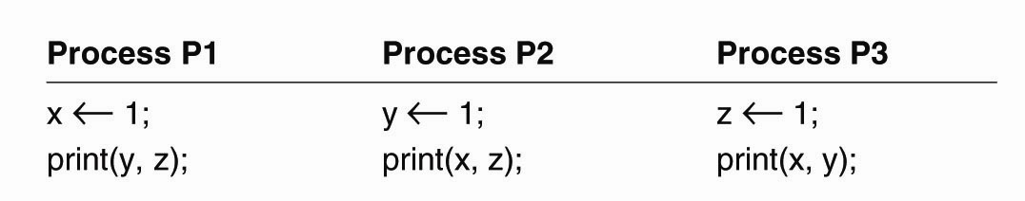

7.2 Consistency Models (7)
  Example: Three processes run independently. Not all possible reading sequences are valid
  Assignment = WRITE operation
  Print = READ operation
    Assumption: x, y, z all initialized to 0
Figure 7-6. Three concurrently-executing processes.
CSI3344

Slide 16
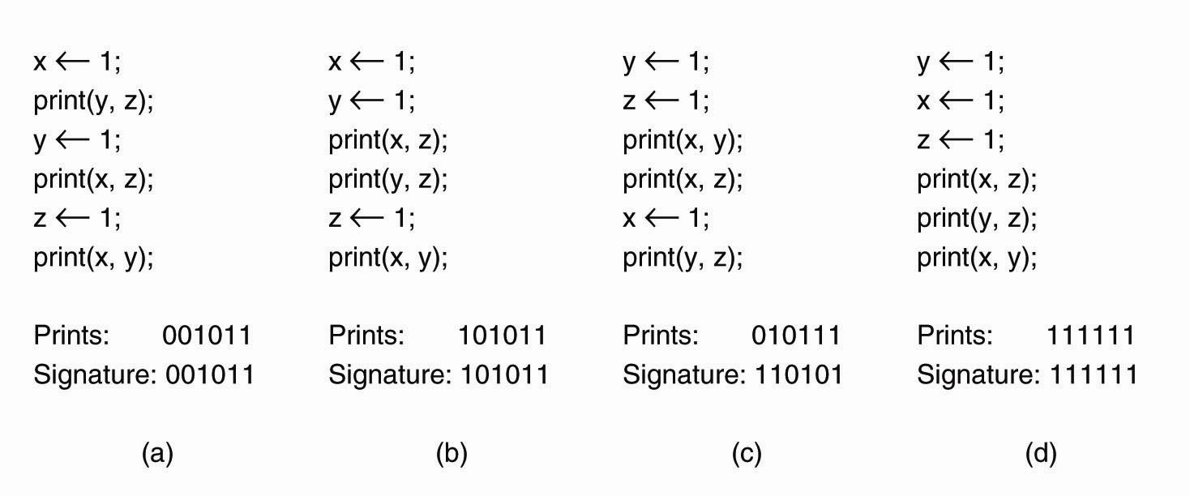
7.2 Consistency Models (8)
  Example: Four valid execution sequences
  Prints - concatenation of outputs in order
  Signature - concatenation of outputs in order of P1, P2 & P3
➔ How many valid
execution sequences &
signature sequences?
-- However signature 000000 and 001001 are invalid (why?)
CSI3344
Notes:
If mapping the above sequences into a Sequence Consistency Model, only (d) would meet the requirement.
Notes: all valid signatures must contains at least three 1’s. Why?
But How many valid output orders (exercise it by yourself)?
For each process, assignment must be executed before the print.
How many valid execution sequences orders?
- altogether of (6+12+12) *3 = 30* 3 = 90
How many valid signature sequences ?
- you give a go?
Signature sequence: output sequence of
print(y, z); (at P1)
print(x, z); (at P2)
print (x, y); (at P3)
(as they appear in the execution sequence)

Slide 17

7.2 Consistency Models (9)
Causal consistency (1)
  Necessary condition:
  Writes that are potentially casually related must be seen by all processes in the same order. Concurrent writes may be seen in different orders on different machines.
    (Causal First W in First R out)
The Write W2(x)b & W1(x)c are
all potentially casually related to
W1(x)a, so all processes see
R(x)a and R(x)b (as well as R(x)a
and R(x)c) in the same order.
However, the Write W2(x)b &
W1(x)c are concurrent, so it is
not required that all processes
see them in the same order.
Consistent casually
CSI3344

Slide 18
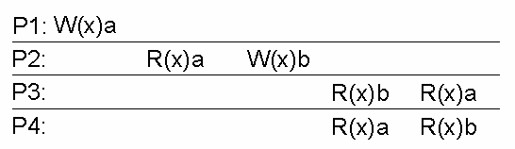
7.2 Consistency Models (10)
Causal consistency (2)
  Necessary condition:
  Writes that are potentially casually related must be seen by all processes in the same order. Concurrent writes may be seen in different orders on different machines.
    (Causal First W in First R out)
W2(x)b potentially depends
on W1(x)a because b may be
a result of a computation
involving the value read by
R2(x)a. The two writes are
casually related. So all
processes must see them in
the same order.
Not consistent casually
CSI3344
Notes:
W2(x)b potentially depends on W1(x)a because b may be a result of a computation involving the value read by R2(x)a. The two writes are casually related. So all processes must see them in the same order. Therefore the two reads of P3 and P4 are incorrect.

Slide 19
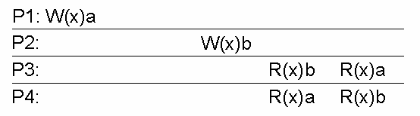
7.2 Consistency Models (11)
Causal consistency (3)
  Necessary condition:
  Writes that are potentially casually related must be seen by all processes in the same order. Concurrent writes may be seen in different orders on different machines.
    (Causal First W in First R out)
W1(x)a and W2(x)b are
not causally related,
thus different processess
may read them in
different order
Consistent casually
CSI3344
Notes:
W1(x)a and W2(x)b are not causally related, thus different machines may read them in different order

Slide 20
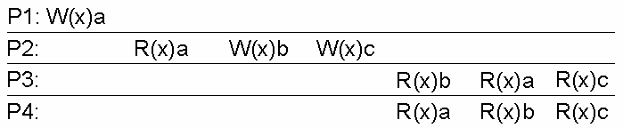
7.2 Consistency Models (12)
FIFO consistency (1)
  Necessary Condition:
  Writes done by a single process are seen by all other processes in the order in which they were issued, but writes from different processes may be seen in a different order by different processes, i.e., all writes generated by different processes are concurrent. (Single FWIFRO)
FIFO consistent
CSI3344

Slide 21
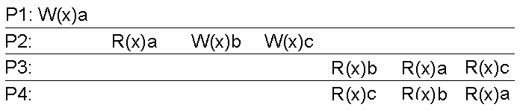
7.2 Consistency Models (13)
FIFO consistency (2)
  Necessary Condition:
  Writes done by a single process are seen by all other processes in the order in which they were issued, but writes from different processes may be seen in a different order by different processes, i.e., all writes generated by different processes are concurrent. (Single FWIFRO)
Not FIFO consistent
CSI3344

Slide 22
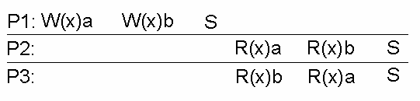
7.2 Consistency Models (12)
Weak consistency (1)
  Shared data can be counted on to be consistent only after a synchronization is done (Synchronized sequential consistency)
Synchronization point
A valid sequence of events for weak consistency
CSI3344

Slide 23
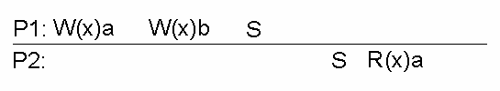
7.2 Consistency Models (13)
Weak consistency (2)
  Shared data can be counted on to be consistent only after a synchronization is done. (Synchronized sequential consistency)
Since P2 has synchronized
before reading, it must see
b (i.e., the last Write result),
not a
An invalid sequence for weak consistency
CSI3344
Notes:
Since P2 has synchronized before reading, it must see b, not a

Slide 24

7.2 Consistency Models (14)
Release consistency
  Shared data are made consistent when a critical region is exited. (Released sequential consistency)
An valid sequence for release consistency
CSI3344
Notes:
Acquire operation vs. release operations ➔ lock (L) and release (L)

Slide 25
Grouping Operations
Necessary criteria for correct synchronization
An Acquire access of a synchronization variable is not allowed to perform until all updates to guarded shared data have been performed with respect to that process.
Before an exclusive mode access to a synchronization variable by a process is allowed to perform with respect to that process, no other process may hold synchronization variable, not even in nonexclusive mode.
After exclusive mode access to synchronization variable has been performed, any other process’ next nonexclusive mode access to that synchronization variable may not be performed until it has performed with respect to that variable’s owner
CSI3344
Notes:
1. at an acquire, all remote changes to the guarded data must be made visible.
2. Before updating a shared data item, a process must enter a critical section in excusive mode to make sure that no other process is trying to update the shared data at the same time
3. If a process wants to enter a critical region in nonexclusive mode, it must first check with the owner of the synchronization variable guarding the critical region to fetch the most recent copies of the guarded shared data.

Slide 26

7.2 Consistency Models (15)
Entry consistency
  Shared data pertaining to a critical region are made consistent when a critical region is entered. (Entered sequential consistency)
An valid sequence for entry consistency
CSI3344

Slide 27
7.2 Consistency Models (16)
Summary of consistency models (1)
  Consistency models without synchronization operations
Consistency | Description
Strict | Absolute time ordering of all shared accesses matters.
Sequential | All processes see all shared accesses in the same order. Accesses are not ordered in time
Causal | All processes see causally-related shared accesses in the same order.
FIFO | All processes see writes from each other in the order they were used. Writes from different processes may not always be seen in that order
CSI3344

Slide 28
7.2 Consistency Models (17)
Summary of consistency models (2)
  Consistency models with synchronization operations
Consistency | Description
Weak | Shared data can be counted on to be consistent only after a synchronization is done
Release | Shared data are made consistent when a critical region is exited
Entry | Shared data pertaining to a critical region are made consistent when a critical region is entered.
CSI3344

Slide 29
Major Points
Purposes of data replication
Strict consistency (absolute time ordering)
Sequential consistency
Causal consistency
FIFO consistency
CSI3344

Slide 30
Reading Guide
Normal Reading
DSPP: 7.1 introduction
7.2 data-centric consistency model
Advanced Reading
DSPP: 7.3 client-centric consistency model
CSI3344

